Slide 1

x
🤖
Toronto Police
MMAI Group 11
Prepared By
Annuj Kamalesan 217044322
Parth Malviya 220895736
Pratiksha 220137626
Rupali Wadhawan 220189445
Sadia Ashraf Charoo 220154704
Sreekanth Potlabathini 220088993

Slide 2






Problem Statement
Priority Level | 2019 Performance vis-a-vis Targets
 | 1995 Response Time Targets | % Not Met | % Met
 | 6 minutes | 72% | 28%
 | 6 minutes | 92% | 8%
Auditor General (Romeo-Beehler, 2022)
1
2
Toronto Police Services (TPS) management lacks knowledge of the required response timings to effectively reduce shooting incidences, deaths, and injuries.
Problem Statement
Solution
External Analysis
Next Steps
Mockup
Notes:
Switch yellow to blue

Slide 3












Solution: Purpose and Scope
Toronto Police Patrol Program
🤖
Ensure minimal response time
1
Transformed Dataset
AI Heatmap
Performance Guidelines
Create Insights for Divisional Performance
2
Quality of Life Changes & Continuous Support
Support & Integration
3
Best Practices
Support needed
Patrol Schedule
Priority
Problem Statement
Solution
External Analysis
Next Steps
Mockup
Notes:
Toronto Police Patrol Program
Turn 1,2,3 into sentence fragments and add icons to represent to grammar
Turn this into a flowchart and UI in implementation

Slide 4




External Analysis (PESTEL)
Regulatory Considerations
(Toronto Police Services Board)
Technology Considerations
(Toronto Police Services Board)
Time constraint
Moderate Risk
Structure insights to attain this objective.
Mitigation measures & monitoring guidelines
Auditor General (Romeo-Beehler, 2022)
(Toronto Police Services Board, 2022)
70%
Reporting response time
121 min
Avg. Clearance time
Lack of training
I/CAD
Communicate with I/CAD.
Training documentation
Integration with I/CAD, TRMS, and ArcGIS.
Use location tracking
Auditor General (Romeo-Beehler, 2022)
Auditor General (Romeo-Beehler, 2022)
Problem Statement
Solution
External Analysis
Next Steps
Mockup
Notes:
Reformat 70%

Slide 5


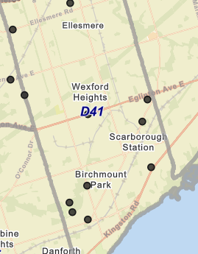
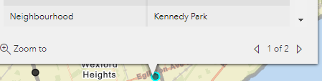
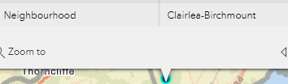
Cleaning and Next Steps
Current Progress
Drop Duplicates
No Outliers Found
Guidelines based on the last 8 years
Heatmap Next Steps
Guidelines Next Steps
Optimal
Define
Compare Divisional Performance
Support Next Steps
Integrate
Create training documentation
Prevent Risks and Create Monitoring KPIs
Problem Statement
Solution
External Analysis
Next Steps
Mockup
Notes:
Run Regression to remove, No Outliers

Slide 6

Prototype Ready July 25th
Thank you for listening
Mockup of Prototype
Artificial Intelligence Heatmap
1
SEE MOCKUP IN GITHUB README
Insights for Divisional Performance
2
Problem Statement
Solution
External Analysis
Next Steps
Mockup
Notes:
Change this to a simple flowchart

Slide 7
Appendix

Slide 8
CITATIONS
“ArcGIS Online.” Arcgis.Com, www.arcgis.com/index.html. Accessed 5 June 2023.
2. “Artificial Intelligence Procedure Consultation.” Artificial Intelligence Procedure Consultation- Toronto Police Service, www.tps.ca/police-reform/artificial-intelligence-procedure-consultation/. Accessed 5 June 2023.
4. “Data Analytics.” Toronto Police Service Public Safety Data Portal, data.torontopolice.on.ca/pages/data-
analytics. Accessed 5 June 2023.
5. “Free Icons and Stickers - Millions of Images to Download.” Flaticon, www.flaticon.com/. Accessed 5 June 2023.
6. “Intergraph Computer-Aided Dispatch (I/CAD).” Hexagon, hexagon.com/products/intergraph-computer-aided-dispatch. Accessed 5 June 2023.
7. Romeo-Beehler. “Review of Toronto Police Service – Opportunities to Support More Effective Responses to Calls for Service.” Toronto Auditor General, 14 June 2022, www.torontoauditor.ca/report/review-of-toronto-police-service-opportunities-to-support-more-effective-responses-to-calls-for-service/.
8. Romeo-Beehler, www.toronto.ca/legdocs/mmis/2022/au/bgrd/backgroundfile-228234.pdf, 14 June 2022, Accessed 5 June 2023.
9. “Shooting and Firearm Discharges Open Data.” Toronto Police Service Public Safety Data Portal, data.torontopolice.on.ca/datasets/TorontoPS::shooting-and-firearm-discharges-open-data/explore?location=43.696050%2C-79.363765%2C10.00. Accessed 5 June 2023.
10. SWOT Analysis of the Metropolitan Police Department Example.” Free Essays - PhDessay.Com, 17 Aug. 2022, phdessay.com/swot-analysis-of-the-metropolitan-police-department/.
11. “Use of Artificial Intelligence Technology.” Toronto Police Services Board, 19 May 2022, tpsb.ca/policies-by-laws/board-policies/195-use-of-artificial-intelligence-technology.
12. “Use of New Artificial Intelligence Technology Policy - Public Consultation.” Toronto Police Services Board - Artificial Intelligence Technologies Policy - Public Consultation, 5 Aug. 2022, tpsb.ca/ai.

Slide 9
General Stats
Number of Shootings Incidents
Number of Victims per year

Slide 10
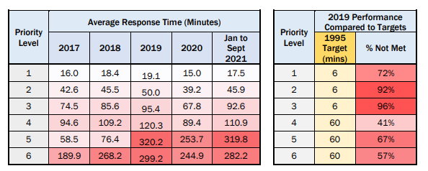
General Stats
Sum of Death and Injuries per year
Priority Level 1 and 2 Average Response Times

Slide 11
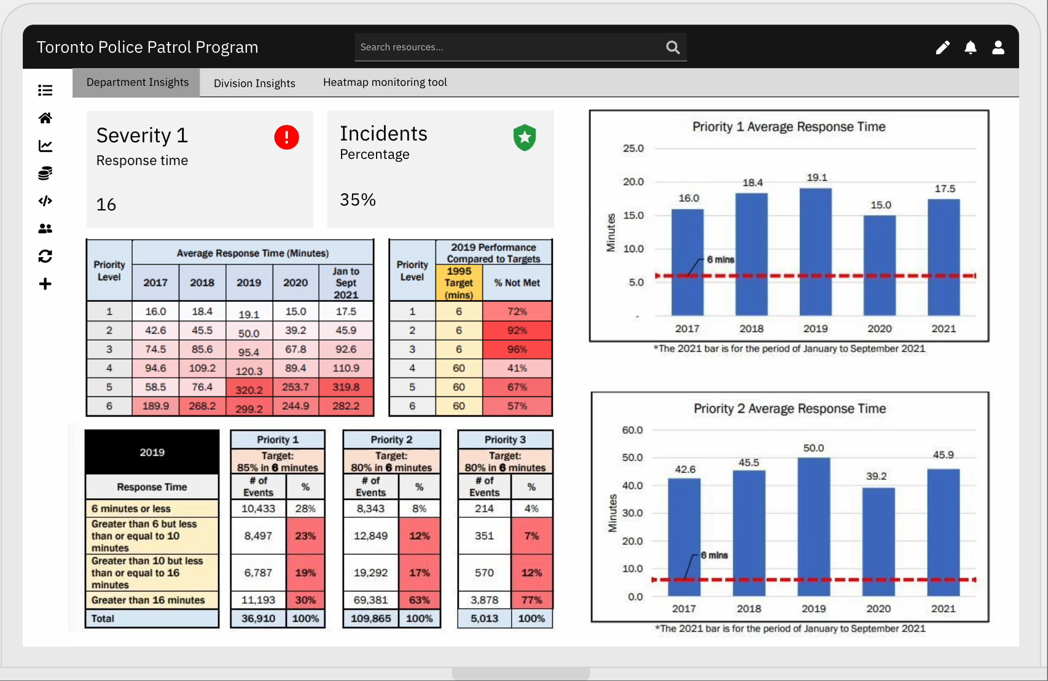
Solution- Old
🤖
Utilizing AI algorithms to create a predictive model that takes in data in real-time, we can accurately identify high-risk areas through an ArcGIS heatmap.
Recommend Optimized Patrol Schedules to ensure minimal response time
1
Create Insights for Divisional Performance (Best Practices/Increased Support)
Analyze the data to create new response time guidelines for shooting incidents based on the historical data
2
Integrate with TPS Time Resource Management System(TRMS), at-scene compliance, internal reporting tools, and live reporting tools
Provide Training documents and support to TPS Management and PRU constables
Quality of Life Changes/Continuous Support to help the external environment integration
3
Notes:
Toronto Police Patrol Program
Turn 1,2,3 into sentence fragments and add icons to represent to grammar
Turn this into a flowchart and UI in implementation

Slide 12
External Environment- Old 1
Political Considerations
(Toronto Police Services Board)
Technology Considerations
The government (TPSB) has set a strategic objective for the TPS has a strategic objective to move to a 70/30 split between reactive and proactive service with its approximate 1600 contracted PRU constables across 17 divisions.
The government (TPSB) has a Draft AI Policy, which categorizes our project as a medium-risk technology due to the factors of privacy and the ability to perpetuate biases against specific communities.
1
2
Our tool must consider the number of officers per division and the constraint 70% of reactive service when creating new guidelines.
1
Our tool must follow the AI policy procedure by providing the potential risks to the TPSB, the mitigations to those risks, along with monitoring guidelines for privacy and discrimination
The TPSB has noticed that the at-scene compliance for recording response time is 70% (2019)
The TPSB has noticed that there is a high clearance time, with an average of 121 and 102 mins for priority 1 and 2 calls
The TPS has used technology like I/CAD for the initial call process, ArcGIS for mapping &
TRMS for police resource scheduling
The TPS is continuously improving its use of technology yet needs training at all levels to ensure a smooth implementation
Our tool can help at-scene compliance by communicating with I/CAD auto-generate time
Our tool can help with clearance time by communicating with I/CAD to autofill reports
2
Our tool can help ensure guidelines are met by having training documentation and continuous levels for the constable level, divisional level, and chief of police level
Our tool can help integrate with existing technology by communicating with I/CAD, TRMS, and ArcGIS
3
3

Slide 13

External Environment- Old 2
Regulatory Considerations
(Toronto Police Services Board)
Technology Considerations
(Toronto Police Services Board)
Time constraint: Only 70% of PRU constable time allocated for response calls
TPSB Draft AI Policy classifies our project as High Risk due to potential bias against communities
Our tool must consider the number of officers per division and the constraint 70% of reactive service when creating new guidelines.
Our tool must follow the AI policy procedure by providing the potential risks to the TPSB, the mitigations to those risks, along with monitoring guidelines for privacy and discrimination
1
2
1
At-scene PRU compliance for reporting response time
121 min
Average clearance time for priority 1 and 2 calls (shootings)
I/CAD
102 min
2
Our tool can help ensure guidelines are met by having training documentation and continuous levels for the constable level, divisional level, and chief of police level
Our tool can help integrate with existing technology by communicating with I/CAD, TRMS, and ArcGIS
Our tool can help at-scene compliance by communicating with I/CAD auto-generate time using location
Our tool can help with clearance time by communicating with I/CAD to autofill reports
3
3

Slide 14
PESTEL Analysis
Political factors | Higher crime rate can affect the political stability. Reduced criminal victimization. Need Research for changes in policies for the crimes spikes. Identify the new acceptable laws that can reduce the crime rate. Criminal justice system efficiency in keeping the criminals off the street.
Economical | Negatively affect a countries economy if the crime rate is high. Low budget for the police department. Use of financial resources fairly.
Socio-cultural | Should align with the public opinion and the impact High crime rates. Bringing the response time down. Quick identification of the location. Reduce fear of crime and enhance the personal security. Satisfy citizen demands for prompt, fair and effective services. Prioritize the crime prevention. Organized crime networks.
Technological | Forecasting method - Advancement in terms of app. Availability of surveillance. Communication method. Predictive analytics tools. Privacy concerns.
Environmental | Neighborhood – infrastructure and design. Urban vs Rural areas. Increasing population. Access to public spaces and recreational activities. Opinion towards crime. Opinion towards Toronto police’s reaction time.
Legal | Policies in crime preventions. Effectiveness of crime reporting. Existing policies and Standard Operating Procedures. Responsibility of reduced response time.

Slide 15
General Stats
Strength | Weakness
Implementing a robust protocols based on 'broken window' theory (if something happens deal with it immediately). Community partnership. Experience that comes with being in service for 189 years. Empathy support in critical situations. | Limited funding available . Increased demand for services due to population growth. Time span between filling vacant positions and new hires finishing their initial training. Communications within the departments.
Opportunities | Threats
Integration with AI could support the limited funding. CALEA accreditation and improved standards. Smart growth with the utilization of technology. Increased communication internally. Enhance support and participation of communities to enhance law enforcement. | Growing problem of firearm related death and injury. Public sentiment. Media misrepresentation. Change of policies.

Slide 16
Algorithm and Next Steps
HeatMap Algorithm
Clean the data
Identify Outliers
Define Variables in dataset that need to be created
Define which ones need to inputted and which ones need to created by the AI
Define the filters for the data
Define the factors that will affect the data
Code the Artificial Intelligence model to use the dataset to predict the predicted variables
Test to see if it generates an output
Test to see if it generates an output given the filters
Test to see if the factors impact the output given
Integrate the artificial to display results of the output on ArcGIS
Test to see if it generates an output on ArcGIS, given the filters
Test to see if the factors impact the output given on ArcGIS
Guidelines Algorithm
Decide what data to use for the analysis
Utilize Heatmap to find optimal allocation of resources for the data
Identify factors that might affect the optimal allocation of resources
Decide how to incorporate those factors into the analysis
Determine realistic allocation of resourcs
Compare divisional performance data to realistic and optimal standards
Identify the top performing divsions and the reason why they are performing well
Identify the lower performing divisions and figure out how to support them

Slide 17









Variable Justification
Current Progress
Drop Duplicates
No Outliers Found
Drop 2004 to 2014 data for deliverable 2
Variables to Create (for AI to predict)
Customization Filters and Factors
Danger Variable (Shortest response Time + Past Crimes)
Past Data Scenarios
Slider for what data to include in model
Number of Police Cars per division = Estimated to be 37
Pull Request: I am an sergeant from division 11 and I want to know where to put police cars for the month of June output a recommendation from 3 p.m. to 9 p.m.
Longitude and Latitude of Police Station/Cars
Response Time
Station & Police Car Response Time
Traffic, Speed, IsHoliday/IsEvent, Season
Notes:
Run Regression to remove, No Outliers

Slide 18
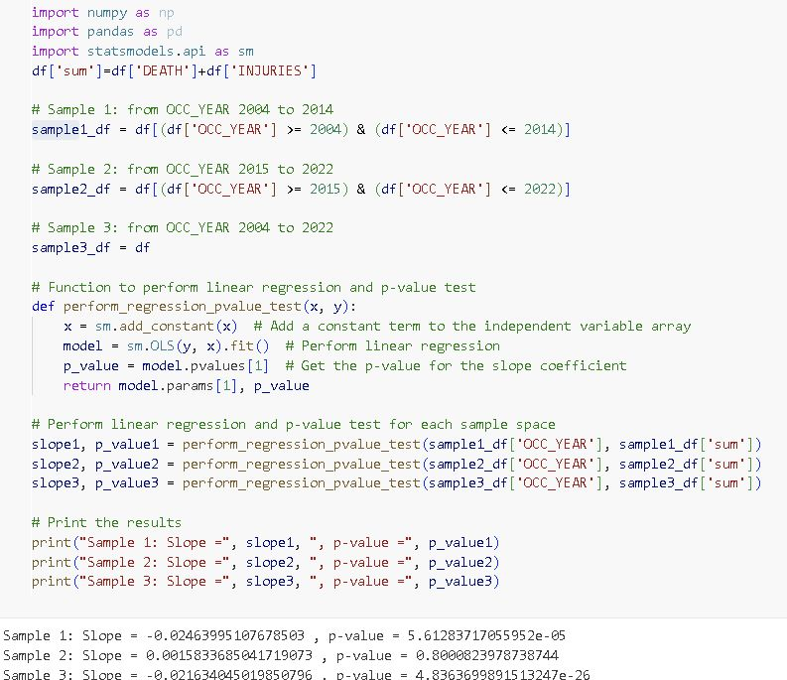
Regression
Sample 1 P-Value: 5.61
Sample 2 P-Value: 0.80
Sample 3 P-Value: 4.83
Accept Null as P-Value > 0.05

Slide 19
Assumptions
We are assuming that police are unable to shootings get to the unmonitored areas before the crime ends because of distance, traffic, and lack of police cars in the area. However it could very well be because of reports are too late for them to respond.
In my proposal distance is going to be the straightest path as the calculation is just going to be between the two longitude and latitude. However it would be nice if we could somehow account for driving on the actual roads by using a google map integration to calculate the actual time based on the driving route distance.
In my proposal we are placing police cars at a central location in the neighborhoods at x time based on the danger that need to be monitored but they would likely not be stationary this causes variation in the time they would approach wherever the AI predicts the crime. Also I'm not sure how the AI is going to move them based on time like if the position needs to change to maintain response time under 10 minutes from 6 to 7 is it realistic for the car to actually get there.
On the rare occasion that multiple shootings occur within a central division or in the more likely scenario where a police car is dealing with another crime dispute how would we account for that in the prediction model.
Obviously in an ideal world we would have police cars in every neighborhoods to have a less than 1 minute response time however we need to build in a certain budget and/or limit to how many neighborhoods can be monitored at once. Alternatively we can recommend some lighter areas to have surveillance rather than a full on patrol due to cost and types of crime occuring.
There will be the need for multiple response time variables since we do not have access to the current divisional patrol schedules as our tool is going to generate a recommend based on the historical data and also use historical data to generate a recommendation for the present.
Therefore there will be station response time which assumes the police car was sent directly from the station which creates a response time based on shortest path to crime + speed travelled based on traffic (time of day). Then there will be a patrol response time which finds the closest patrol car location based on the tools recommendation and makes the response time calculation (applies to where the police cars should've been based on the past and where they should be based on predictive data/live reporting tool)

Slide 20
Cleaning and Next Steps
Current Progress
Drop Duplicates
No Outliers Found
Guidelines based on the last 8 years
Heatmap Next Steps
Guidelines Next Steps
Support Next Steps
Danger Variable (Shortest response Time + Past Crimes)
Define Variables to Predict
Heatmap = Optimal Allocation of Resources
Identify how to integrate with TPS technology
Define Filters and Factors
Define = Realistic Allocation of Resources
Create training documentation for TPS
Code and Test Predictive Model
Compare Divisional Performance
Prevent Risks and Create Monitoring KPIs
Integrate Model with ArcGIS
Problem Statement
Solution
External Analysis
Next Steps
Mockup
Notes:
Run Regression to remove, No Outliers

Slide 21
PRU Constable Estimate
1600 PRU Constables
Approximately 7% or 113 PRU constables away for leave - (Romeo-Beehler, 2022)
Approximately 14% or 230 PRU constables assigned to light duty- (Romeo-Beehler, 2022)
Assuming two constables per PRU dispatch unit especially for priority 1 and 2 calls
17 divisions in the TPS
1600-230-113= 1257
Approximately 1257 deployable officers at a given time (will factor in the variation in the model)
1257/2= 628.5
Cant have half a person so approximately 628 units at a given time
628/17 = 36.94 patrol units per division
Approximately 37 patrol units per division (some might be in one car)
Assuming each officer works 10 hour shifts
https://developers.google.com/optimization/scheduling/employee_scheduling

Slide 22

Old Graphics
Past Data Scenarios
Response Time Variation
Codify Neighborhoods
Problem Statement
Solution
External Analysis
Next Steps
Mockup

Slide 23
Code File

